Slide 1
Index Number Revision
Paper 1: Index and weighted index numbers
Paper 2: Chain based index numbers
CPI
RPI
GDP
RECESSION
CRUDE BIRTH /DEATH RATES
STANDARD POPULATION
STANDARDISED RATE

Slide 2
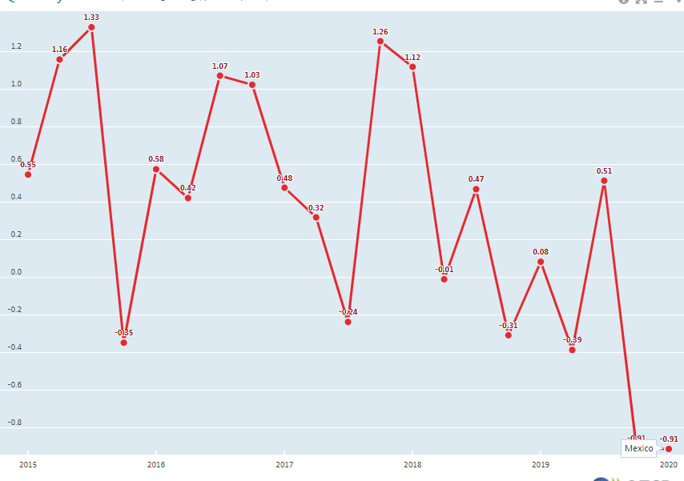
1
What is the base year for RPI?
What is the base year for CPI?
2
Calculate the chain base index numbers for this data.
2018 | 106
2019 | 106
2020 | 105
2021 | 107
3
State when this country Mexico first went into recession.
https://data.oecd.org/chart/6EBq

Slide 3
4
Create a standard population for countries A and B listed below:
Age group | Country A Population | Country B Population
0-29 | 6 000 000 | 1 500 000
30-59 | 5 500 000 | 550 000
60+ | 2 500 000 | 120 000
Age group | Country A | Country B
0-29
30-59
60+

Slide 4
5
Using your standard population from Question 4 calculation a standardised death rate for each Country:
 | Country A |  | Country B
Age group | Number of Deaths | Population | Number of Deaths | Population
0-29 | 7 000 | 6 000 000 | 6 300 | 1 500 000
30-59 | 20 000 | 5 500 000 | 3 000 | 550 000
60+ | 120 000 | 2 500 000 | 120 000 | 120 000
 | Country A |  |  | Country B
Age group
0-29
30-59
60+

Slide 5

6
Comment on the standardised death rates in Countries A and B

